Slide 1
Research-based Group Project

Slide 2
Multi Document Summarization (MDS)
Documents
Summary
Model

Slide 3
Graph-based MDS
Paragraphs
Documents
Summary
Model
Graph represents relations between textual units (e.g paragraphs/sentences)

Slide 4
Graph-based MDS
Sentences
Documents
Summary
Model
Graph represents relations between textual units (e.g paragraphs/sentences)

Slide 5
Research Questions
Which textual units (paragraphs vs sentences) are best as vertices to capture context and dependencies of the input documents?
How can you detect which textual units were used to create a summary within an abstractive MDS model?

Slide 6
Sentences vs Paragraphs
Data
Pre-Processing
Paragraph-Level Data
Sentence-Level Data
Model 1
Model 2

Slide 7
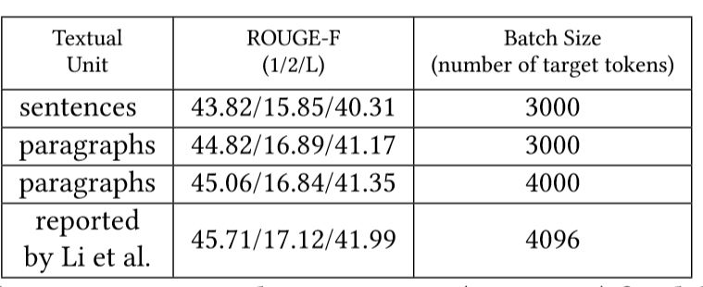
Sentences vs Paragraphs

Slide 8
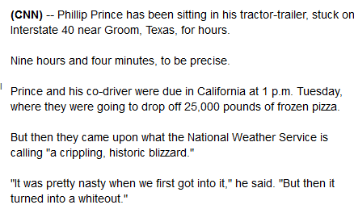
Paragraphs in News-Article

Slide 9
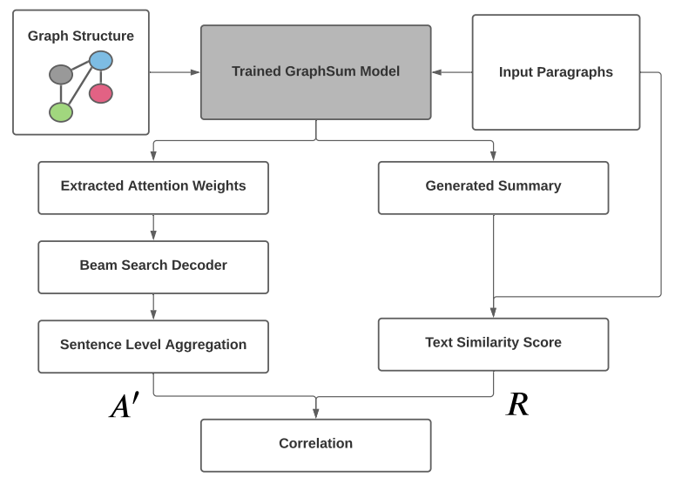
Source Origin Analysis

Slide 10
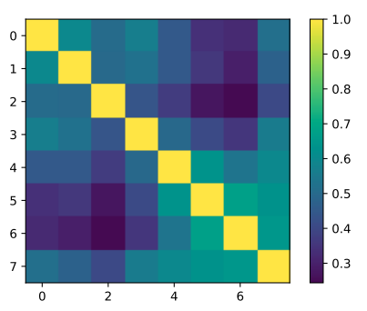
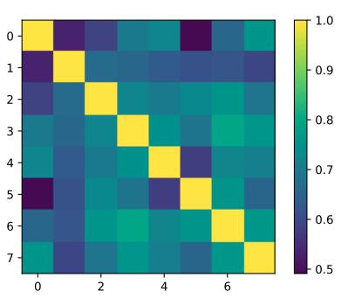
Correlation-Analyse
Decoding Layer
Multi-Heads

Slide 11
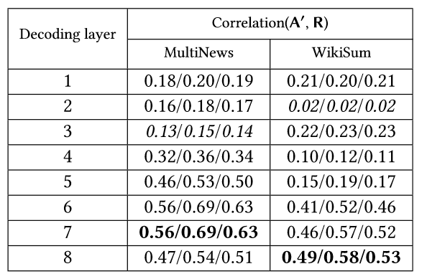
Source Origin Results
Low Correlation
High Correlation

Slide 12
Positional Bias

Slide 13
Challenges / Limitations
PaddlePaddle not commonly used in English speaking community
Compatibility problems of PaddlePaddle
Resource Limitations restricted experiments

Slide 14
Contribution
Selection of textual units depends on domain of Multi Document Summarization
Attention weights can help to improve explain ability of “Black box”

